Slide 1
Profile Manager

Slide 2
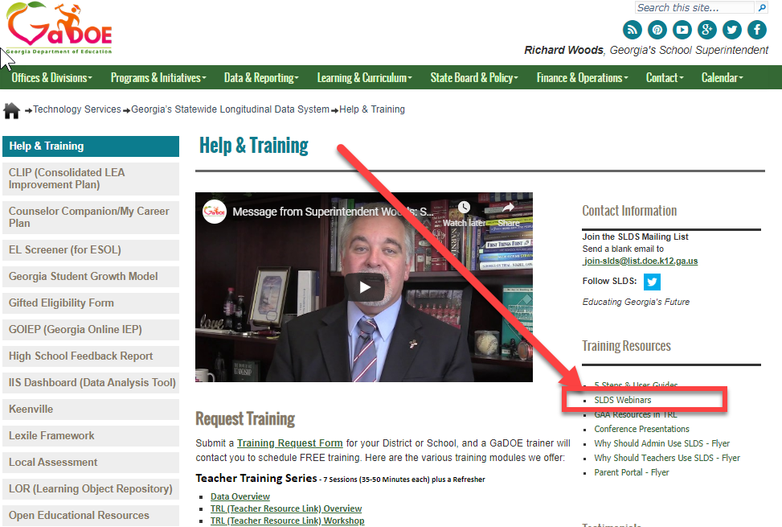

Slide 3
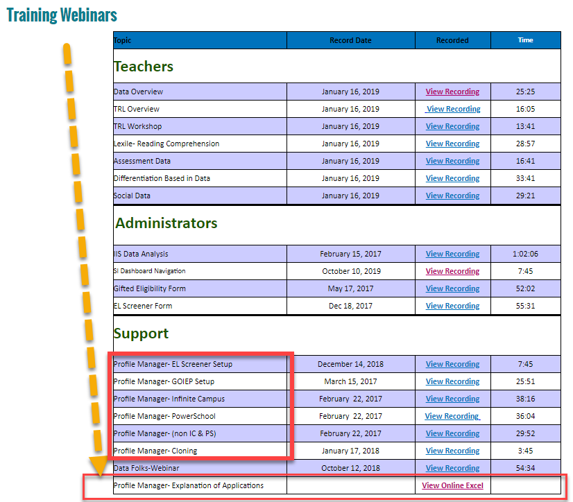

Slide 4
SLDS Role error
Resolution: Assign an approved Role or Confirm the ROLE has been “provisioned” on the DOE side. Appears that the user has an SLDS ROLE that has not been setup correctly. This could be one of two things:
Profile Manager or “Super User” has created a ROLE inside of SIS, but that ROLE has not been provisioned on the DOE side.
Profile Manager has created a role- but the Role name in Profile Manager does not match exactly the token inside of the SIS.

Slide 5
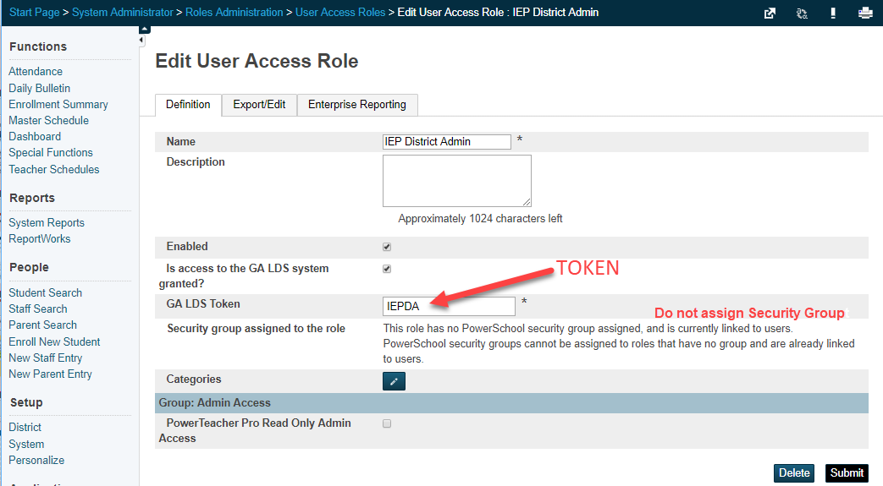
PowerSchool

Slide 6
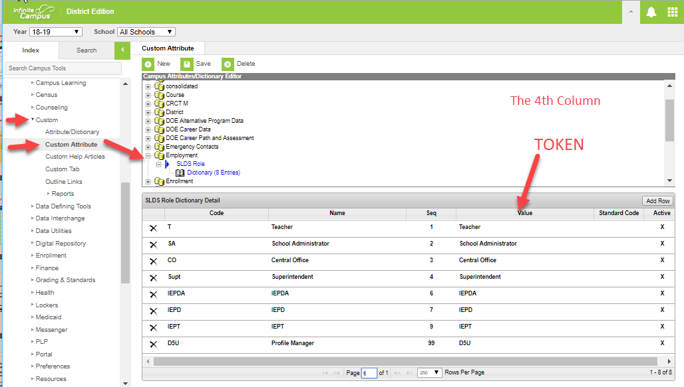
Infinite Campus

Slide 7
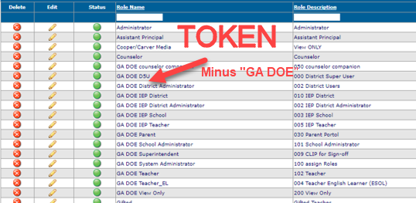
Tyler SIS

Slide 8
To add/delete/edit Roles to access SLDS
Only One USER Role is able to access the Profile Manager – that is the D5U not to be confused with the TKES Super User.
As the D5U user – the only application available is the Profile Manager.
The new role CANNOT have an “&” in the name/token.
The new Token in the SIS must match EXACTLY the SLDS Role Name.

Slide 9
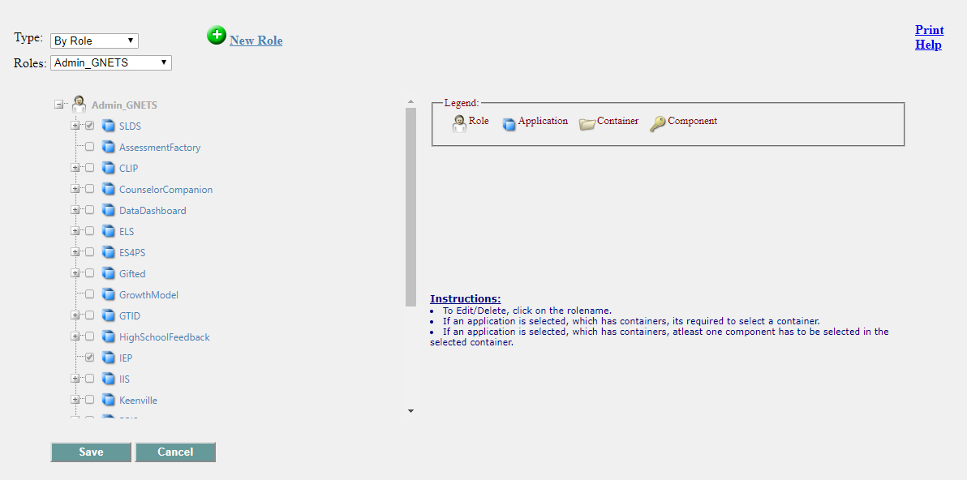
By default – this is what the “D5U” / “Profile Manager” will look like. Notice there are NO other applications available.

Slide 10
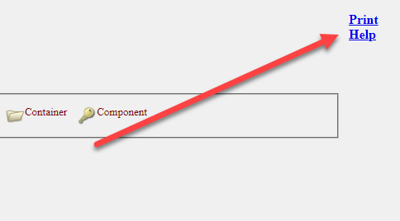
User can Print/Export to Excel the ROLES and their associated “levels”

Slide 11
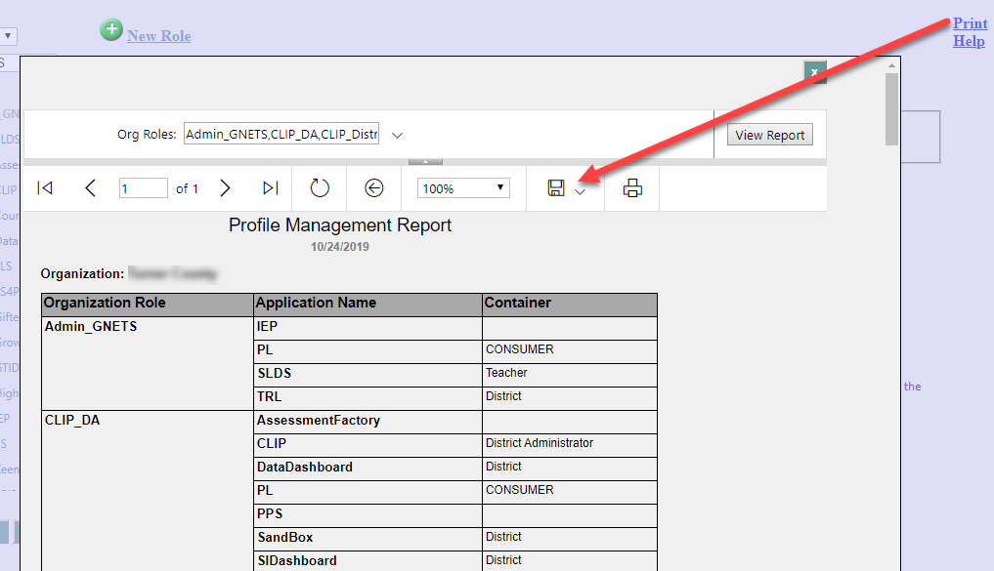

Slide 12
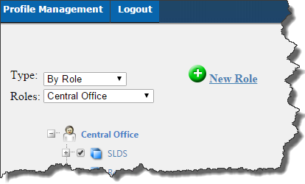
You can select One Role to view or One Application to view:
Role
Application
By default it displays the first Role.
You can change Role by selecting the desired Role from the 2nd Dropdown

Slide 13
Only ONE Role will be displayed at a time. Changes can only be made to one Role at a time. You should SAVE before moving to next Role.

Slide 14
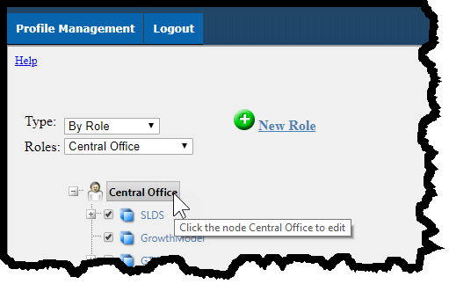
To EDIT an existing Role Name

Slide 15
To ADD a new ROLE

Slide 16
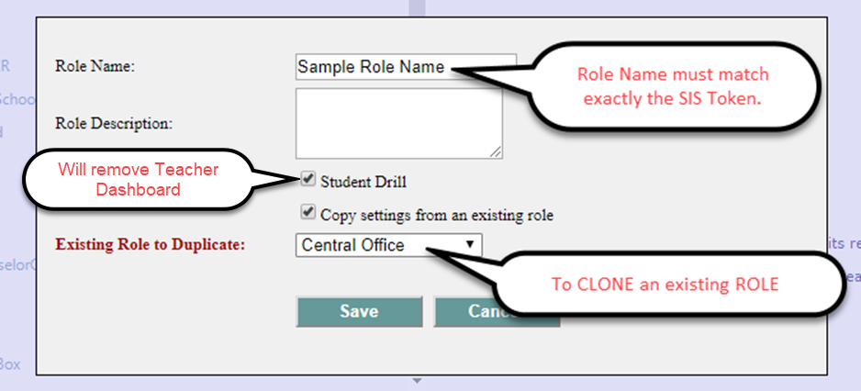

Slide 17
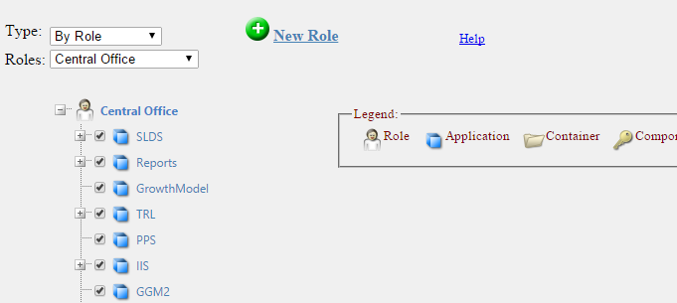
To assign access to a ROLE

Slide 18
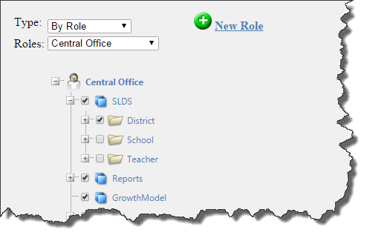
To access container of the ROLE
By clicking on the PLUS [ + ] sign beside the Application (blue cube), You open the options for the Applications. This is usually the LEVEL of access.

Slide 19
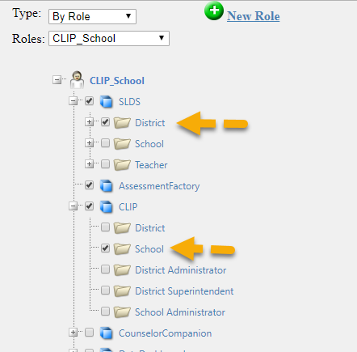
A ROLE can have DIFFERENT levels for different applications- for example a District level in SLDS, but a School level in CLIP (or vice versa)

Slide 20
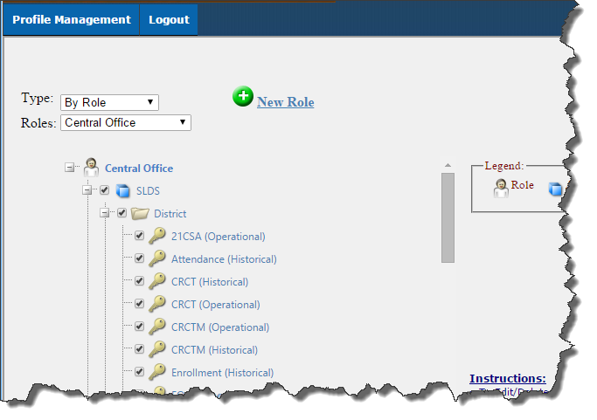
To access components of the ROLE
By clicking on the PLUS [ + ] sign beside the Container (folder), You open the options for the Container, which is Components.

Slide 21
Before new Role can used :
New Role will need to be created using the “Profile Manager” with the correct applications assigned.
New Role will need to be added to your SIS. This may require you to create the Role or your SIS vendor must t create the Role.
Once the New Role has been completed on both sides, the New Role can be used (assigned) to users in your SIS.
Best Practice- always test the new ROLE before assigning it to a user.

Slide 22
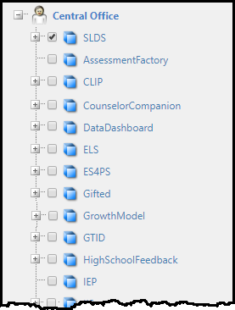
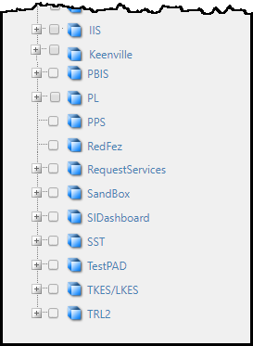

Slide 23
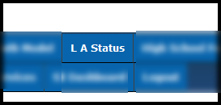
LA Status
Local Assessment Status

Slide 24
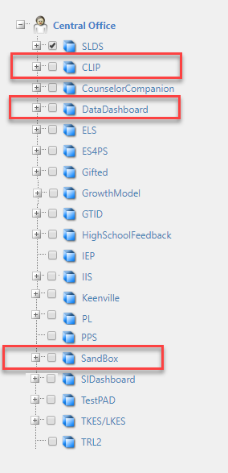
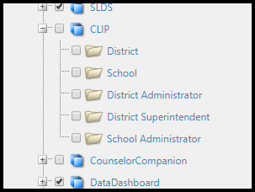
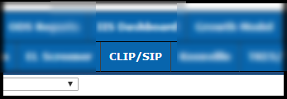
CLIP / SIP

Slide 25
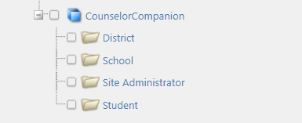
Counselor Companion

Slide 26
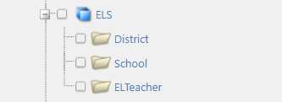
EL Screener

Slide 27
ES4PS
Equitable Services for Private School

Slide 28
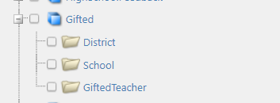
Gifted

Slide 29
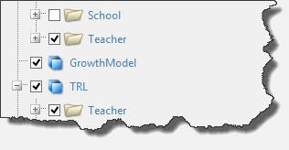
Growth Model (green bubbles)

Slide 30
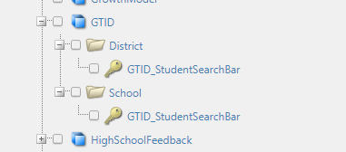
GTID

Slide 31
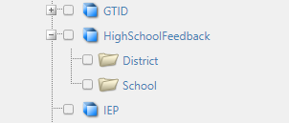
High School Feedback

Slide 32
Georgia Online IEP

Slide 33
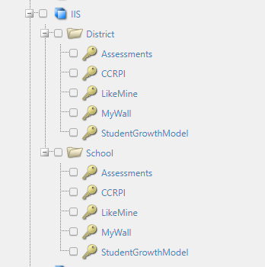
IIS Dashboard – Data Analysis Tool

Slide 34
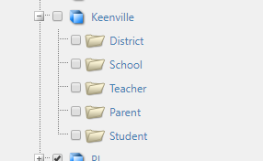
Keenville

Slide 35
PBIS

Slide 36
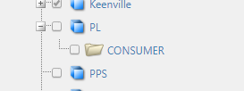
PL
Professional Learning

Slide 37
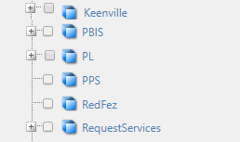
Parent Portal Support

Slide 38
RedFez

Slide 39
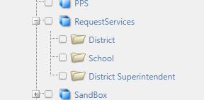
Request Services

Slide 40
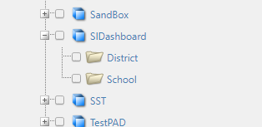
SI Dashboard
School Improvement Dashboard

Slide 41
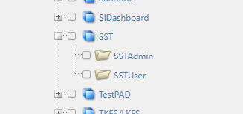
SST
MTSS/SST

Slide 42
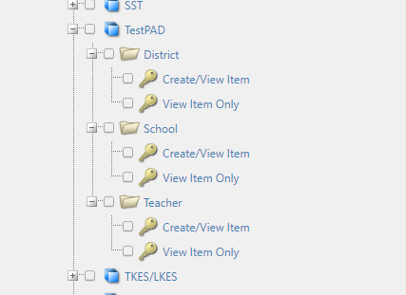
TestPad

Slide 43
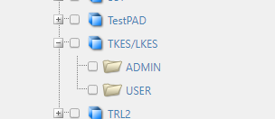
TKES/LKES

Slide 44
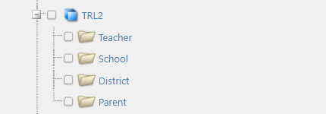
Teacher Resource Link

Slide 45
For Help or Assistance
dTicket@doe.k12.ga.us
Hubert Bennett
HBennett@doe.k12.ga.us
(404) 576-2415 (cell)
bit.ly/SLDS_HelpTraining

